Slide 1
ATM INTERFACE
TEAM REDS

Slide 2
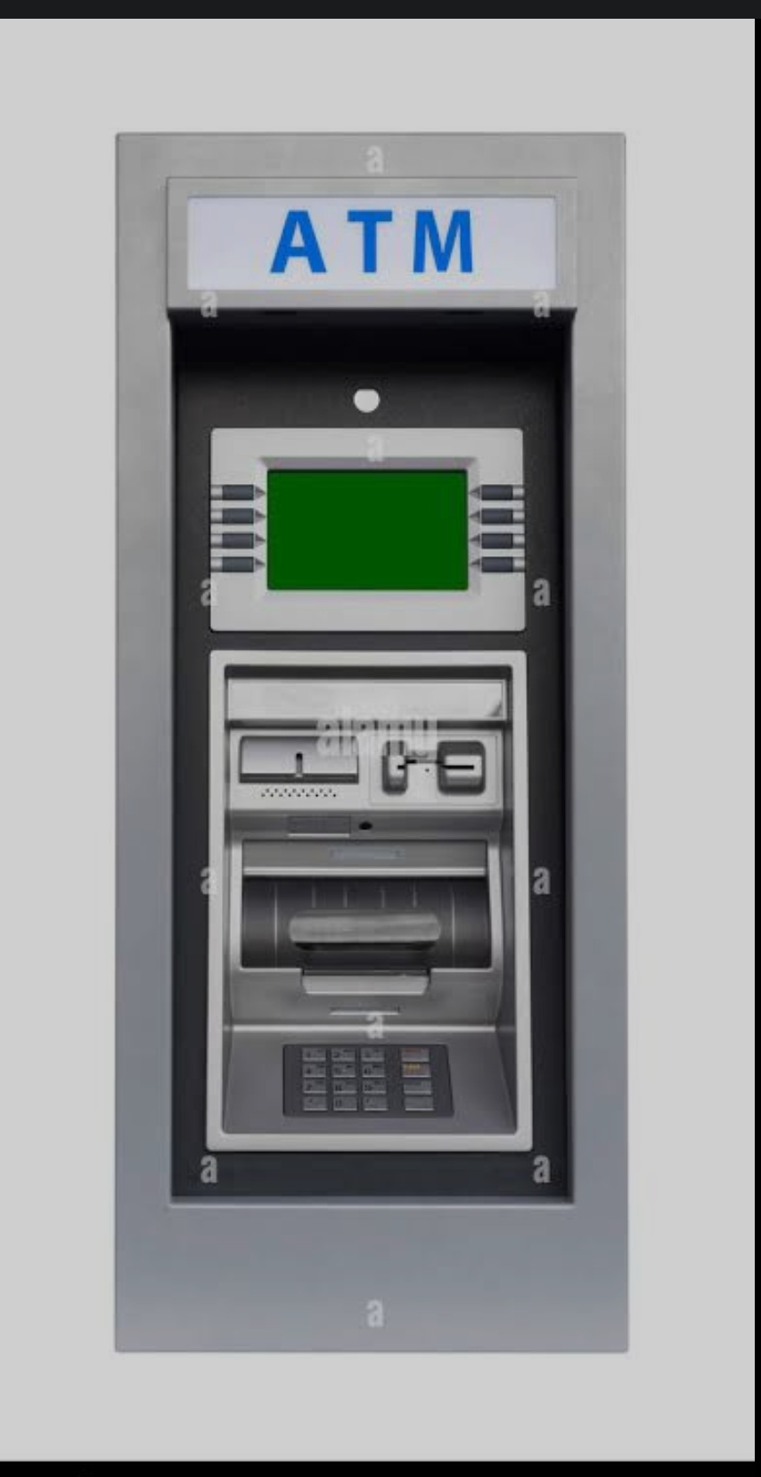
Introduction for ATM
Java, we can create an ATM program for representing ATM transection. In the ATM program, the user has to select an option from the options displayed on the screen. The options are related to withdraw the money, deposit the money, check the balance, and exit.

Slide 3
Code

